Slide 1

Department of Computer Engineering
Mini Project
Semester - VII
“College Placement Record Management System”
Guided By: Devangi Rasikbhai Paneri
Prepared By: Tanvi Khokhariya (220002041)

Slide 2
Outline
Introduction
Project Overview
Objectives and Scope
Challenges and Solutions
Diagrams
Implementation and Roadmap
Future Plans
Conclusion
Thank You

Slide 3
Introduction
- Placement records are essential for both students and institutions.
- They help track student performance and career opportunities.
- Manual record-keeping is slow, inefficient, and prone to errors
- Retrieving and updating data manually takes significant time and effort.
- Inaccurate or inconsistent records can lead to confusion and loss of information.
- An automated system is needed to manage placement data efficiently.
- This project aims to simplify placement tracking with accuracy and easy accessibility.
- It provides a centralized platform for storing and managing placement data.
- The system enables quick generation of reports and insights for better decision-making.

Slide 4
Project Overview
- The College Placement Record Management System is a web-based application designed to manage placement data efficiently.
- It stores detailed information about students, companies, job positions, and placement records.
- The system allows easy addition, updating, and deletion of placement records by authorized users.
- Users can filter, sort, and search records quickly based on different criteria like branch, year, or company.
- Reports can be generated and exported for analysis or official purposes.
- It provides secure access, ensuring data integrity and confidentiality.
- The system reduces manual effort and minimizes errors compared to traditional record-keeping methods.

Slide 5
Objectives and Scope
Objectives:
- Automate placement record management.
- Reduce manual errors and improve data integrity.
- Enable quick access to placement information.
- Provide secure and centralized storage of data.
Scope:
- Admin and user modules for data entry and viewing.
- Filtering, sorting, and exporting reports.
- Scalable to include multiple departments and years.
- Can be enhanced with analytics and job recommendation features in the future.

Slide 6
Challenges and Solutions
Challenges | Solutions
Manual record-keeping errors | Implement digital database with validation
Time-consuming report generation | Automated filtering and export features
Data inconsistency | Centralized storage with controlled access
Difficulty in tracking placement trends | Dashboard with analytics

Slide 7
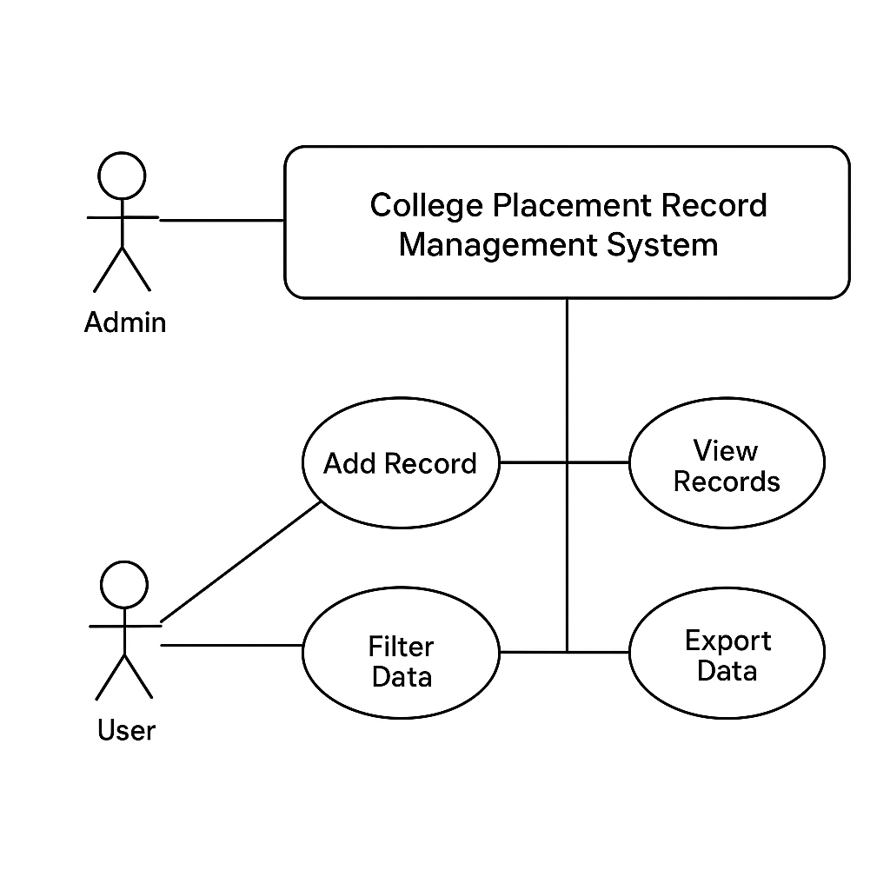
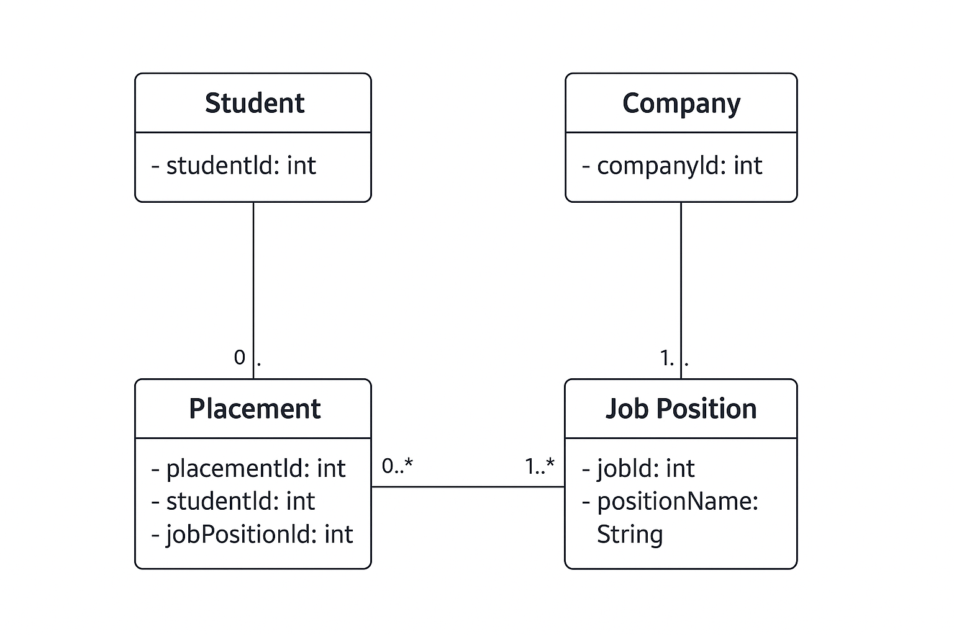
Diagrams
Class Diagram:
Use Case Diagram:

Slide 8
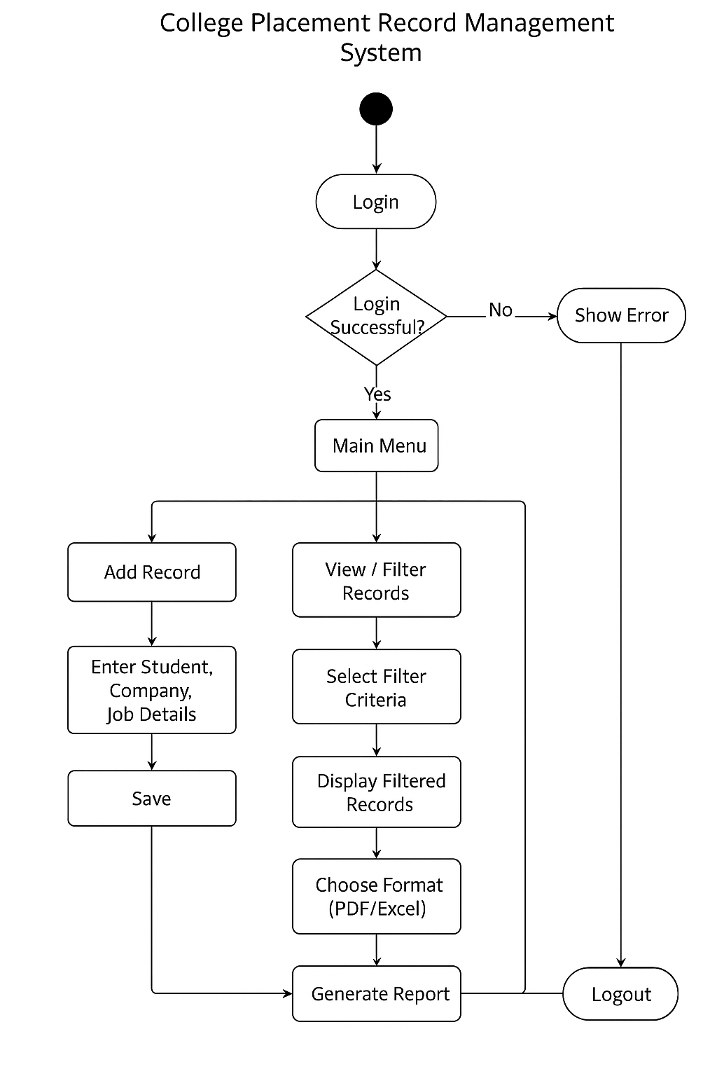
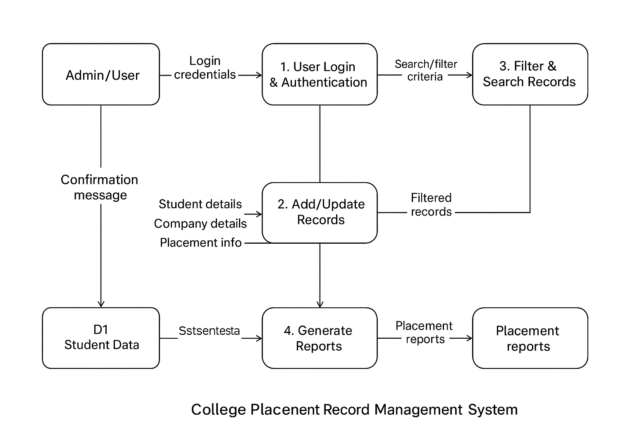
Diagrams
Activity Diagram:
Data Flow Diagram:

Slide 9
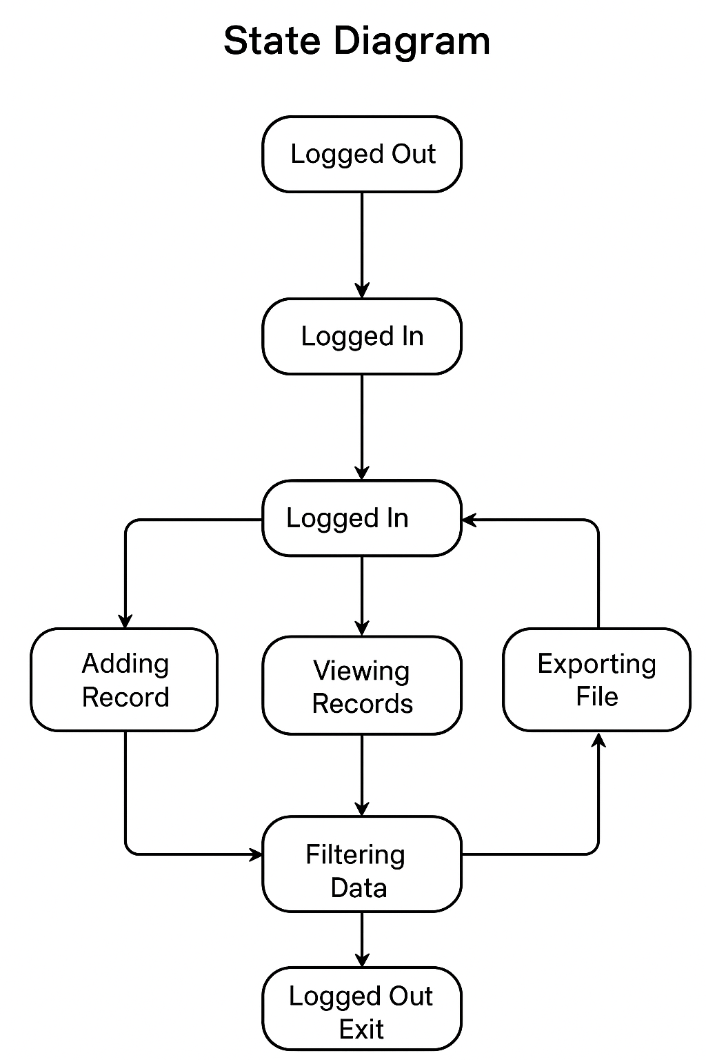
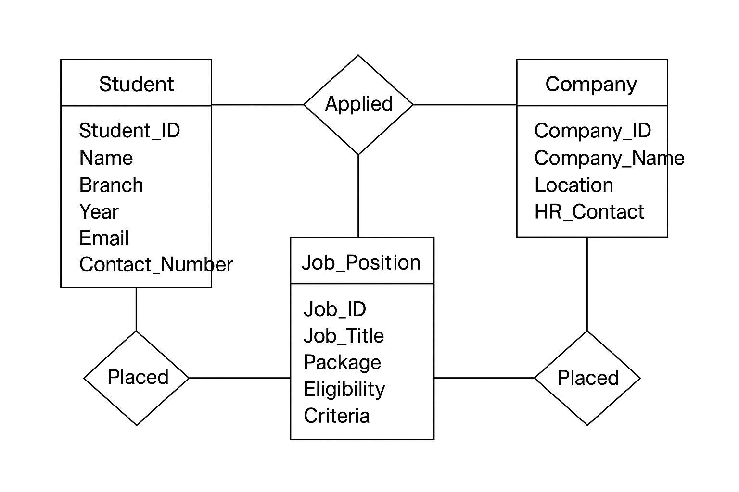
Diagrams
State Diagram:
E-R Diagram:

Slide 10
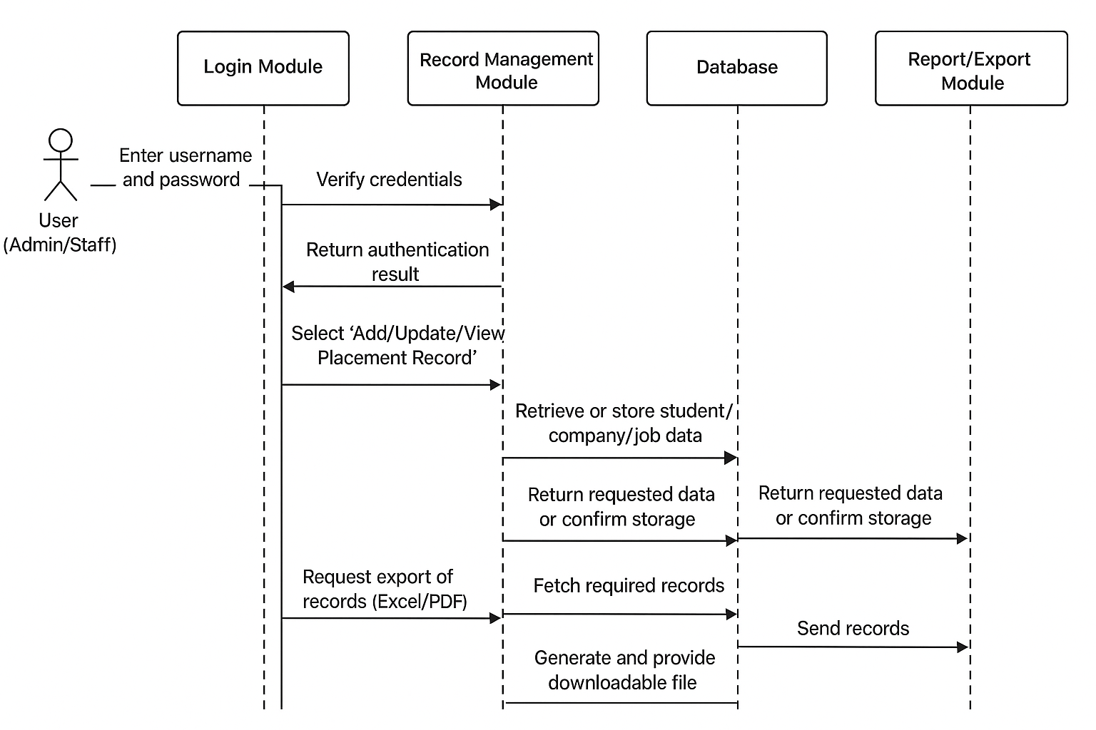
Diagrams
Sequence Diagram:

Slide 11
Future Plans and Roadmap
Future Plans:
- Integration with college ERP systems.
- Advanced analytics for placement trends.
- Resume upload and automated job recommendation system.
Implementation and Roadmap:
Technology Used: Python, Tkinter/HTML-CSS-JS, MySQL/SQLite
Implementation Steps:
- Database design and setup
- GUI / Web interface development
- Data input forms and validation
- Filtering and report generation
- Testing and deployment
Roadmap: Pilot → Feedback → Full deployment → Maintenance

Slide 12
Conclusion
The system simplifies placement tracking and reporting.
Eliminates manual errors and ensures data integrity.
Enhances user experience for both admins and students.
- Provides a reliable platform for long-term placement management.

Slide 13


